Slide 1
Week 5
Using a Repository – Western’s BitBucket

Slide 2
Student Objectives
Upon completion of this video, you should be able to:
List 3 reasons why we are using repositories
Create a new repository in Western’s Bitbucket → https://repo.csd.uwo.ca
Clone a repository
Push files from your local machine to your Western repository
Pull files from your Western repository to your local machine
Push files from your virtual machine to your Western repository
Pull files from your Western repository to your virtual machine

Slide 3
Why are we making you use BitBucket at Western?
If your virtual machine gets corrupted, you will have a backup of all your files.
If your local machine gets corrupted, you will have a backup of your cs3319 (files for this course) files.
If you use our repository system, you can make private repositories for free.
We can check your work for this course (what you did, the dates, etc). The t.a.s and professors all have access to your repositories, even if they are private.
Most importantly for you →
YOU CAN PUT ON YOUR RESUME THAT YOU HAVE USED A REPOSITORY SYSTEM!

Slide 4
Creating and cloning a repository
We are going assume you installed git onto both your local machine and your virtual machine when you set up your victual machine
You should only have to do this step once. You want to
Create a new repository at https://repo.csd.uwo.ca
Projects vs Repositories

Slide 5
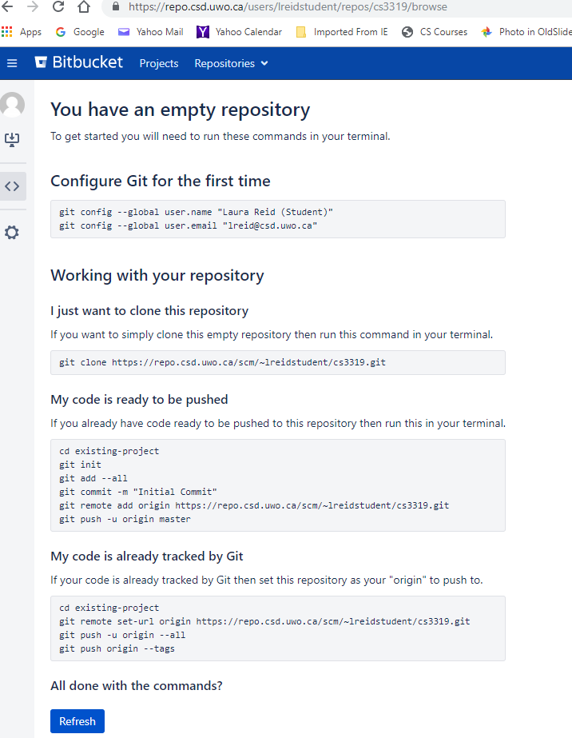
If you haven’t created any files yet
Then go to your local machine
cd to the folder where you want to put all your work
run the command prompt (on Mac/Linus) or Git Bash (on Windows)
Type this command: where the red ? will be filled in the values given to you by Bitbucket
git clone https://repo.csd.uwo.ca/?/~?/?.git

Slide 6
If you Have some files already
Then go to your local machine that has all the files you want to put in this repo and run the command prompt (on Mac/Linus) or Git Bash (on windows)
cd to the folder where you want to put all your work
Type the following commands: where the red ? will be filled in the values given to you by Bitbucket
cd existing-project
git init
git add --all
git commit -m "Initial Commit"
git remote add origin https://repo.csd.uwo.ca/?/~?/?.git
git push -u origin master

Slide 7
Pushing and Pulling From the Local Machine to BitBucket

Slide 8
Pushing and Pulling from the Virtual Machine to BitBucket

